Slide 1

The process of ratification
RAT PPT 2.7
UNESCO
Intangible Cultural Heritage Section

Slide 2
In this presentation...
Process of ratification
Pattern of ratification
Paths to ratification
Case studies

Slide 3
Process of ratification
Member States of UNESCO
May ratify, accept or approve the Convention
Using an instrument of ratification
Signed by head of state, the head of government, or the minister of foreign affairs
Deposited with DG of UNESCO

Slide 4
Patterns of ratification

Slide 5
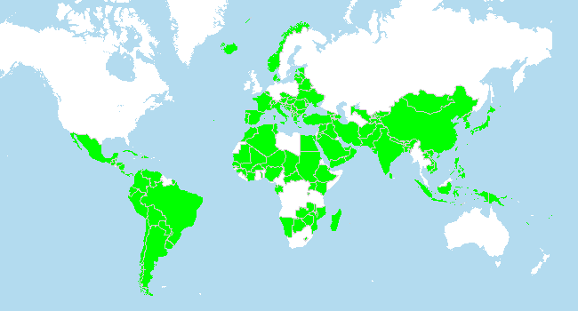
Patterns of ratification
States Parties to the Intangible Heritage Convention, 2010

Slide 6
Committee seats per electoral group
(2010-12)
Group I (W. Europe)
Group II (E. Europe)
Group III (S. America)
Group IV (Asia Pacific)
Group V(a) (Africa)
Group V(b) (Arab states)
15 States, 3 seats
22 States, 4 seats
25 States, 5 seats
22 States, 5 seats
28 States, 4 seats
15 States, 3 seats

Slide 7
Towards ratification
Translating the Convention
Consultations
Media campaigns / Lobbying
Establishing an ICH Committee
Legal review / revision
Cabinet & Parliamentary approval
Signing the instrument

Slide 8
Case studies
Croatia
Brazil
Kenya

Slide 9
Croatia
History of expert research on ICH
Supportive ministry appoints National Committee on ICH
Ratified the Convention in 2005

Slide 10
Brazil
“Brazil has had a policy on intangible cultural heritage since 2000 and was involved even before the start of discussions on drafting the Convention ... it was a matter of course for Brazil to ratify the Convention.”
Notes:
Video clip Fonseca interview 13:02:
“I think Brazil is a very special case. Brazil has had a policy on intangible cultural heritage since 2000 and was involved even before the start of discussions on drafting the Convention. We had a preliminary meeting in Rio in January 2002, and it was a matter of course for Brazil to ratify the Convention. This was followed by the normal ratification bureaucracy: no problems with Congress, the Ministry of Culture, the Chamber of Deputies, Parliament – it all went very smoothly, but I think that Brazil is really a case apart. I don’t know whether it could serve as a model for other countries.”

Slide 11
Kenya
“So it takes a lot of lobbying, a lot of briefing, and a lot of people from the grassroots and the mainstream government management systems” to get a Convention ratified.
Notes:
Video clip Anami interview:
“But one important thing was about the same time we were having [a] constitutional review process in the country and so we lobbied for information of a Culture Committee which was chaired by the Nobelist Maathai. So she was the chair and so she was expecting many people and went into that committee and we were actually asking for more than just ratifying the Convention. We were asking for a culture chapter being introduced in the national constitution. So, that after that it was not a very strange thing for us now to present to the Cabinet our requests for approval to ratify the Convention. Of course which would mean that we’ll have to review a lot of general policies in different ministries and we made sure that those ministries had discussed what they wanted and we had discussed with them we wanted. So it was not difficult then for them to work with us once we submitted the Cabinet memorandum. But it wasn’t there that easy sailing. We had to withdraw the Cabinet memorandum on two occasions. The first occasion [is because] was because they had collision parties got into conflict so they were voting for opposite things so we had to withdraw a bit. Then there was a Cabinet reshuffle and then we had to start the lobbying again. But finally at 2007 we were able to have it ratified. Again, 2007 we are going to have election and that election eventually became explosive. We had post-election conflicts, but Thank God, we had ratified the just before the election. So it takes a lot of lobbying, a lot of briefing, and a lot of people from the grass-root and the mainstream government management systems. That is how we were able to lobby.”

